Slide 1
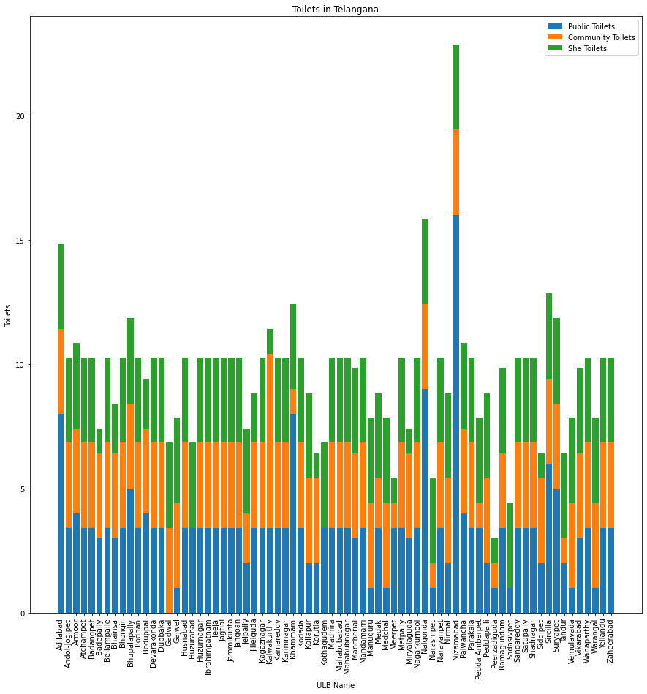
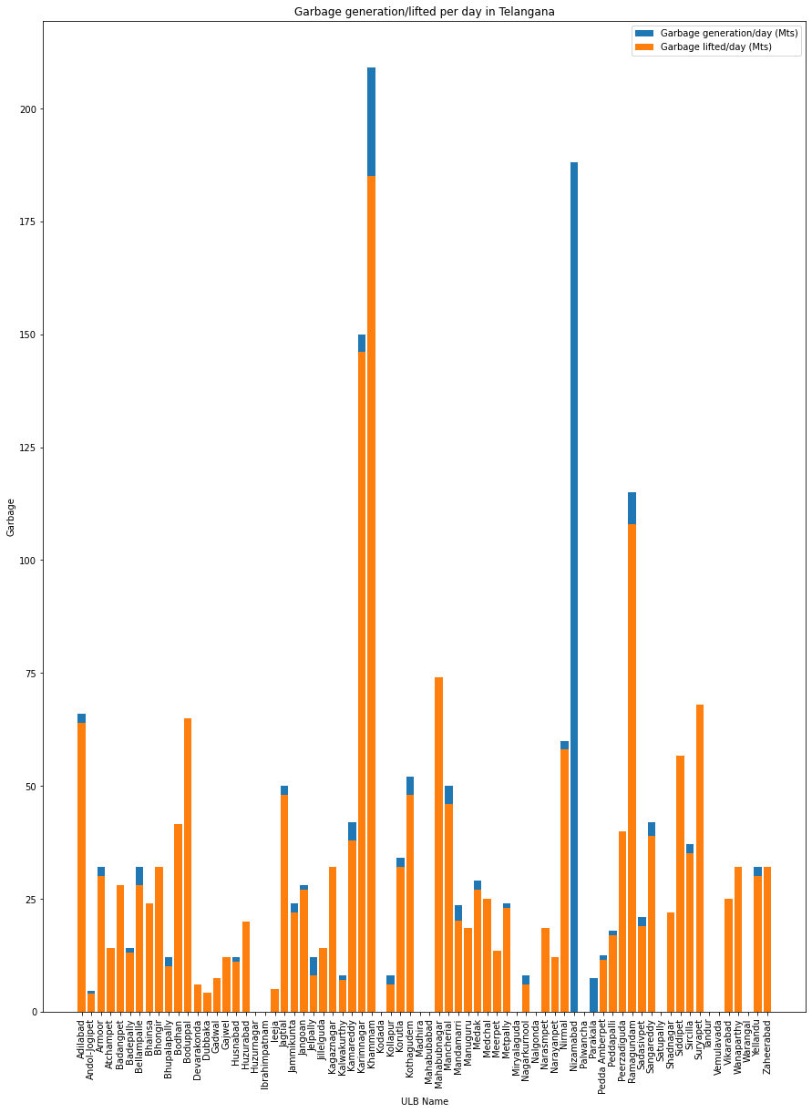
CLEAN WATER AND SANITATION
Analysis on the current status and causes of or solutions to clean water and sanitation in Telangana
Completed by: U Narendra sagar, K Sadanand
Chaitanya Bharathi Institute of Technology, Hyderabad
INTRODUCTION
RESULT
CONCLUSION
Telangana was ranked second in the country in providing clean water and sustainable development goals (SDG) . But referring to the given data, public toilets that are in the states of utter neglect and poor maintenance of sanitation in the city. It may reduces human well being , social and economic development. We could see that ODF wards are up to the mark . Availability of toilets and solid waste management and liquid waste management were identified as focus area Disposal of household garbage should be increased. We found Urban Garbage lift percentage is 87.17%
In this study we examine: Performance of Telangana state on Clean water and Sanitation found in a good position. Common compost pits, low cost drainage, soakage channels/ pits, re-use of waste water, system for collection, segregation and disposal of household garbage etc. should be taken up for better improvement.
Initial analysis, we found that telangana is good at maintaining clean sanitation, but after lot of visualization we found that there are some areas need to be improved a lot otherwise it may cause long term problems. Undertaking sanitation works other than Individual Sanitary Latrines such as constructing waste water drains, leveling of mud roads, cleaning the piled up garbage, application of sanitary sprayers and disinfectants, collection of house hold garbage and animal waste will improve garbage lift percentage and will bring better results.
This graph shows the availability of toilets (public toilets, community toilets, She toilets) in the urban areas of telanagana.
METHODS
This graph shows the garbage generation and lifted per day in Telangana.
We found that few urban areas have bad garbage lift percentage,
Apart from those towns remaining
Cities maintained average percentage of garbage lift and few urban areas are maintained good percentage of garbage lift
This results in Urban areas in Telangana are moving towards growth in sustainable development.
Tools
Jupyter Notebook
Voila
Python
Dataset is all about the sanitation in urban areas of Telangana state. First of all we cleaned the data by using data pre processing and data standardizing methods. Then did Exploratory data analysis. Then by using the some visualization libraries started the visualization of the data. Did a lot of analysis by using many libraries.
INSIGHTS
Mobile toilets can be used as public toilets which increases the no of toilets and also it becomes easy for disposal.
Proper drainage system must be build in cities like hyderabad which improves sanitation.
REFERENCES
https://data.telangana.gov.in/dataset/sanitation-urban-local-bodies-telangana
https://sbmgramin.telangana.gov.in/SwachhTelangana/RWShOmePage/HomePage.aspx

